Slide 1
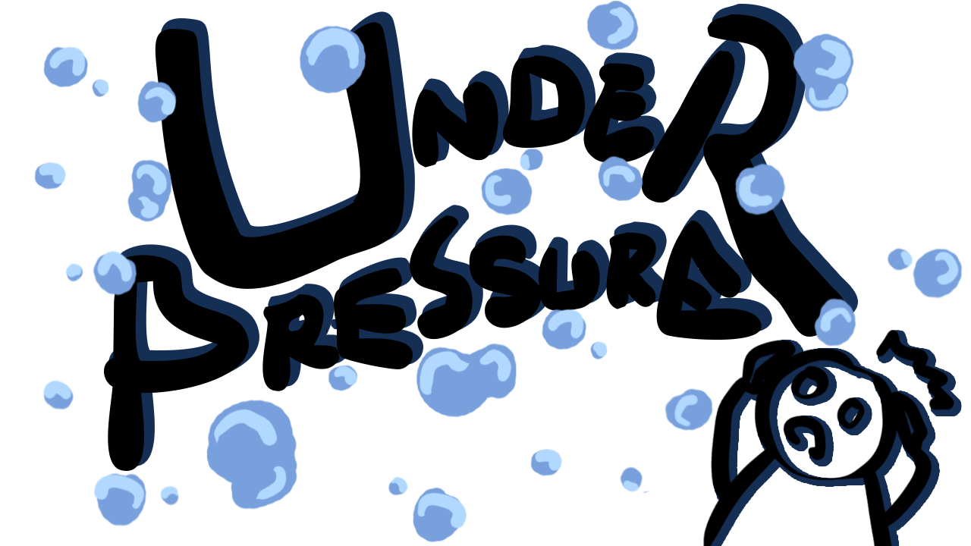
By: Water Pump Games
Yujin Bae, Nicole Poroshenko, Andrew Jamieson

Slide 2
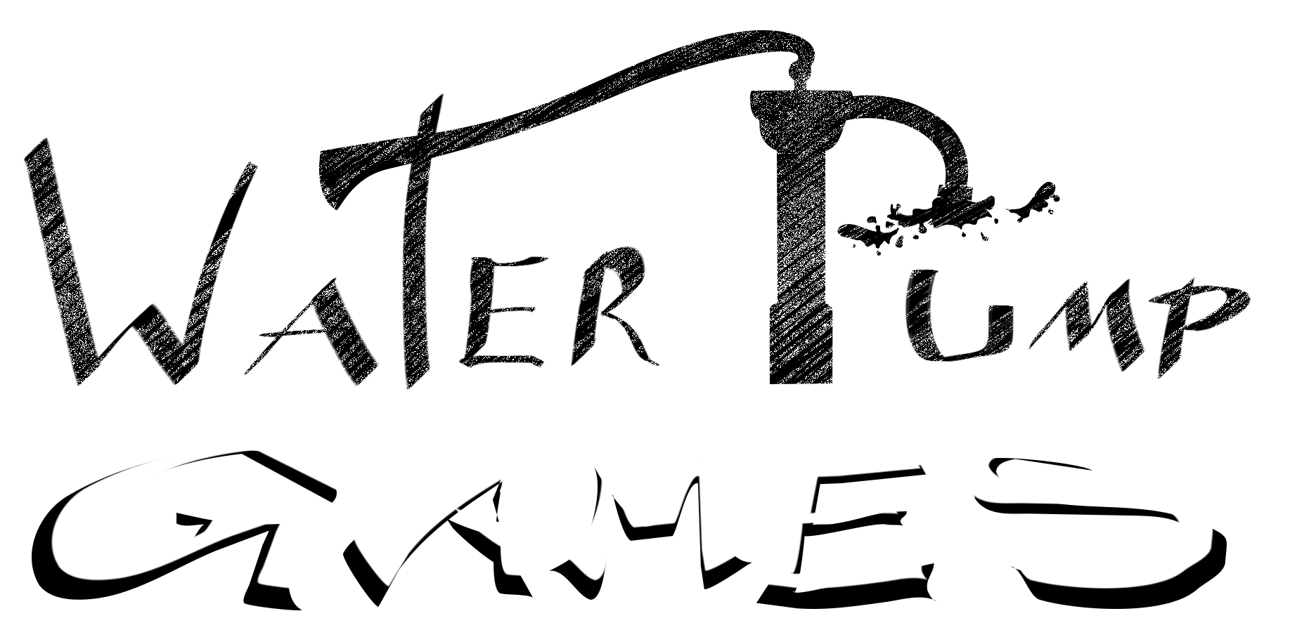
The Team
We have collaborated on multiple projects together throughout the year which means we have developed a good team chemistry. We know how to communicate with one another, have each other’s contact information, and work well as a team for completing work.
Notes:
Yujin

Slide 3
Topic:
Academic Pressure
Age Group:
Junior High-School Students
We chose the topic of academic pressure as it is something that many students have experienced during high school and can relate to.
We chose the target age group to be grade 9 or 10 students who have just entered high school, and may need help coping with the high expectations.
This game is best suited for junior students who are new to highschool and unprepared for the work-life balance. The game guides them through how to deal with the high academic pressures of high school life via a fun & interactive game.
Notes:
Andrew

Slide 4
Path to Success
01
02
03
Difficulties
Obstacles
- Encountering problems we haven’t dealt with before
- Managing workload with overlapping course loads
Creating an idea for the game
Finding entry points to the tasks
Finding reliable sources
Overcoming
Perseverance through difficulties
Consistent work towards our goals
Teamwork & Communication
Notes:
Nicole

Slide 5
New Things We Learned About Java
01
Java Swing
User Input
03
Creating JFrames and JPanels. Adding GUI components (JTextFields, Graphics, etc.)
Taking mouse input and keyboard bindings from the user to advance the game.
02
Graphics
Execution
04
Importing, drawing, fading, overlapping, and animating
Jar and exe file exports and organizing source folders to work outside of JGRASP
Notes:
Yujin

Slide 6
New Things We Learned About Ourselves
How to Persevere
Academic Pressure
One of the largest things we learned about ourselves is the ability we all have to persevere even through difficult times. The fact that we have the ability to keep going despite the obstacles in the way is a big thing we uncovered through the process of the completing the project.
Over the course of the project, somewhat ironically, we learned how we actually deal with academic pressure. While it’s easy to talk about academic pressure and teach about it, finding out how it affects us personally is most likely the biggest thing we learned.
Notes:
Andrew

Slide 7
Conflicts
Communication Issue
Motivation
At the beginning of the project, we had some difficulties engaging ourselves completely with this project and coming up with the creative ideas.
We had a communication problem where members of the group both worked on a segment of code at the same time. Due to that miscommunication, we accidentally ended up with two versions of the same code.
Notes:
Nicole

Slide 8
Resolutions
Communication
Motivation
Made sure to clarify each person’s task at the beginning of the week and keep in contact
We were able to find the motivation by deciding on a topic relevant to us and researching about it to find out more.
Typos
Bugs
We double and triple checked the code to make sure we didn’t have any loops traversing out of bound, lines in the wrong order, or calling a wrong variable
When our program wasn’t working as intended, we collectively read over the problematic code thoroughly for logical errors to find out why it wasn’t working
Notes:
Yujin

Slide 9
Biggest Challenges
Deciding on a good topic and a game concept, as well as a suitable name for the game and the company.
Topic Selection
Having to deal with GUI and Swing components that we haven’t done before.
Java Swing
Researching and asking around for appropriate and reliable information.
Finding Sources
Notes:
Andrew

Slide 10
Biggest Success
Java Swing
Management
Errors
We were able to successfully learn and utilize Java Swing during the development of the game and created a visually appealing and user friendly GUI for our game
Though we encountered many errors during development, with throughout error trapping and reviewing, we were able to remove all errors from our code so that the final game runs foolproof
We were able to follow the initial plan without having to get rid of any elements or falling behind. Rather, we were even able to add additional details and improvements to the game
Notes:
Nicole

Slide 11
Regrets
Things you regret doing and will never do in the future.
Starting without the necessary Java Swing knowledge to complete the graphic components of the game
Planning the project without much information about Java game development and project organization
Notes:
Yujin

Slide 12



Peer Evaluation
Neik Patel
The graphics were brilliant, truly mading me immersed in the game. I also loved the core gameplay loop, which kept me learning without making me bored. The scenarios were quite funny and relatable. The high score implementation was perfect, if only I had gotten a better score.
Andrea Cen
Your game was very informative and fun to play. I enjoyed throwing hands at negative people!
Annie Wong
The art is super cute, level one is informative and the mini games are very fun and interactive for the user. Great game!
Alan Li
I really enjoyed the art and also the concept was very interesting!
IGN:
Metacritic:
Game Informer:
Notes:
Andrew

Slide 13
Game Demo
You can replace the image on the screen with your own work
Notes:
Level 1: Andrew, Level 2: Yujin, Level 3: Nicole

Slide 14
Thanks!
Do you have any questions?

